Slide 1
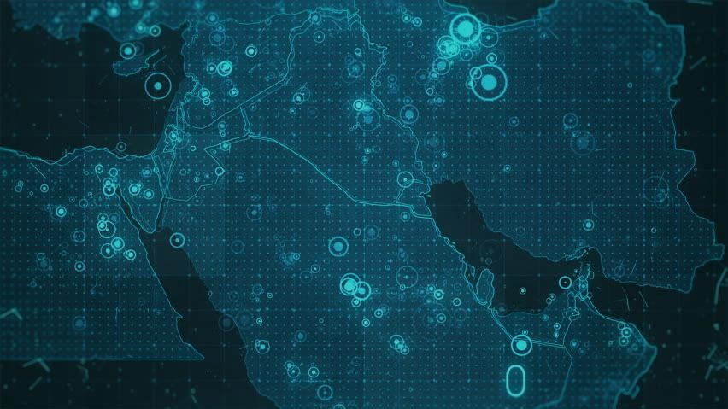

Slide 2
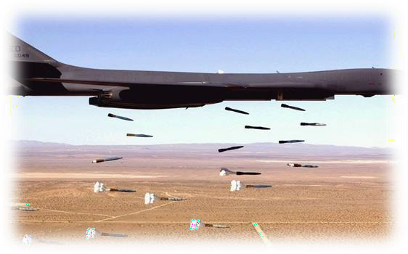
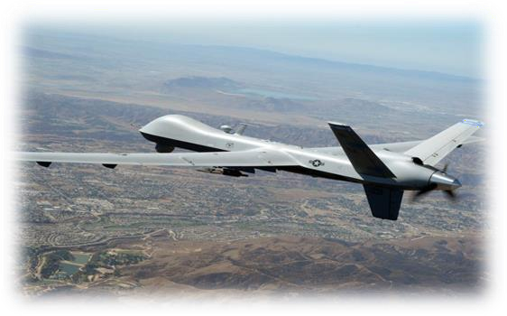
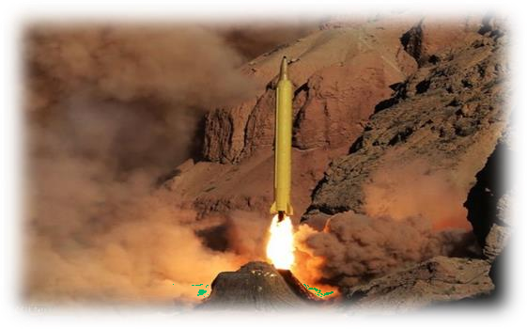
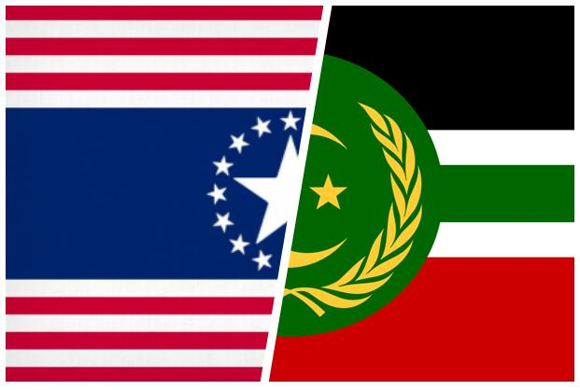
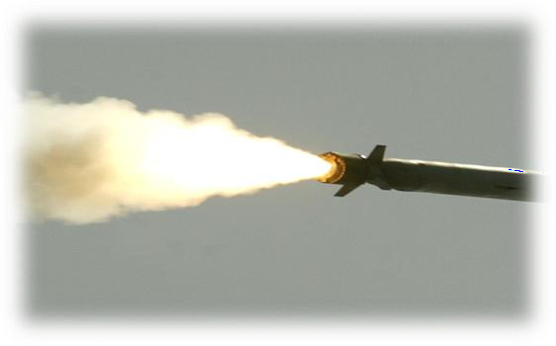
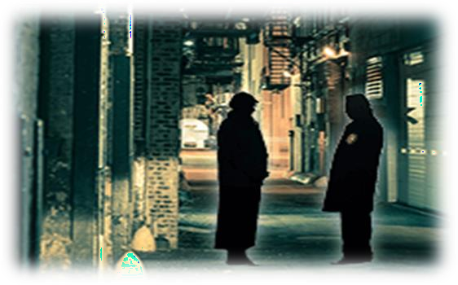
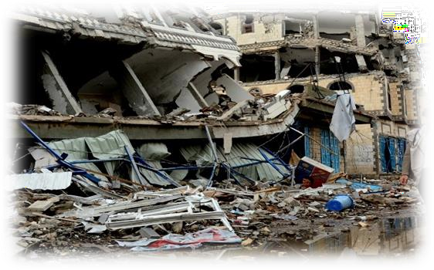
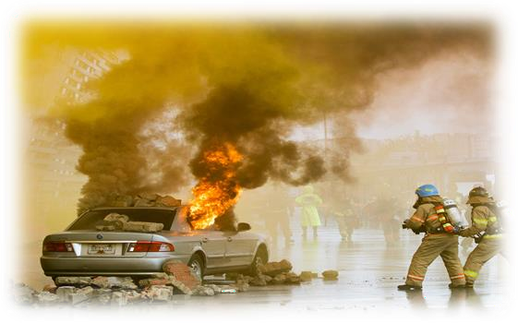
CAPITULATE!
A Wargame of interstate conflict
\
Original Design by Tom Mouat

Slide 3
GAME OVERVIEW
This is an asymmetric game of strategic conflict between two states.
The game is based on the popular children’s game "Battleships" as its basic mechanism, so the rules and mechanisms should be easy to understand..
Both sides use an abstract city map representing their nation's seat of power and influence. It has locations that represent the military industrial complex, others that represent essential services and vital cultural heritage, and others that merely represent populated areas. Each city is hidden from the other team. If all your military infrastructure is destroyed, you are defeated
Each team has four distinct roles: The Political Leader, the Military Commander, the Intelligence Analyst and the Media Advisor. Whilst all play a part it is the Political leader who should have the final say.
Each teams has a set of unique capabilities that can either look at, strike one or multiple areas of the opposing city or to increase their own security. These capabilities are known to both sides.
The teams have already planned the deployment of their military and civilian infrastructure and, hopefully, conducted an assessment of how their opponent might have deployed theirs.
Each game turn consists of two player turns: Freedonian and Authoritanian. In their turn the team may choose to play one capability. To maintain the speed of play team’s will have a max of 1 minute to decide on what they wish to do (this does not include thinking time whilst the opponent acts)
After 10 game turns an International Opinion round will occur. Both sides will present a narrative in the form of a tweet and the spectators (representing the nations not involved in the conflict) will vote on which (if any) they beleive. The winner (if any) will shift the level of international support in their favour.
The game ends when either one side’s military infrastructure is destroyed or they decide to capitulate.

Slide 4
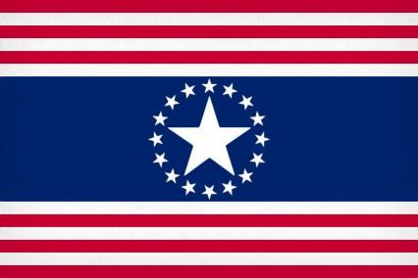
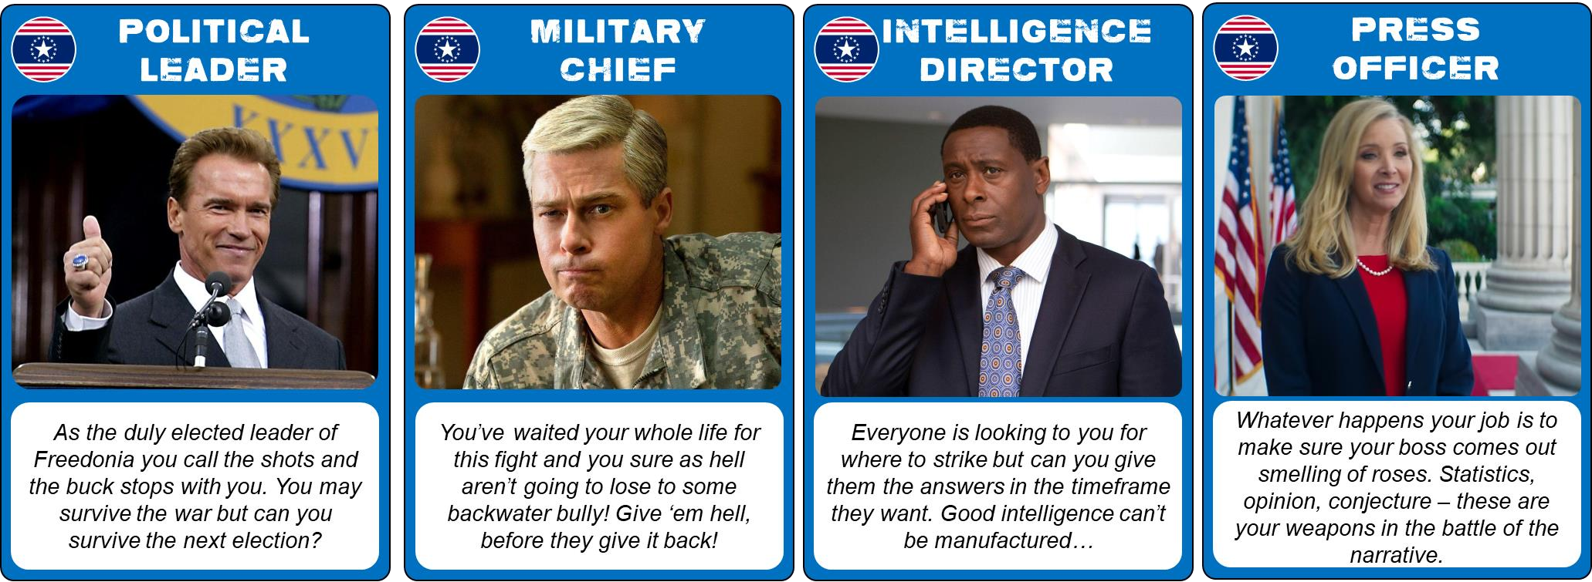
UNITED STATES OF
FREEDONIA
An industrialised Western liberal democracy with advanced weapons devoted to bringing light and goodness to the world.
NATIONAL CHARACTER
A free and open society
Leadership accountable to the people
Significant military and intelligence capabilities
Lower tolerance for civilian
casualties
Lower tolerance for long conflicts

Slide 5
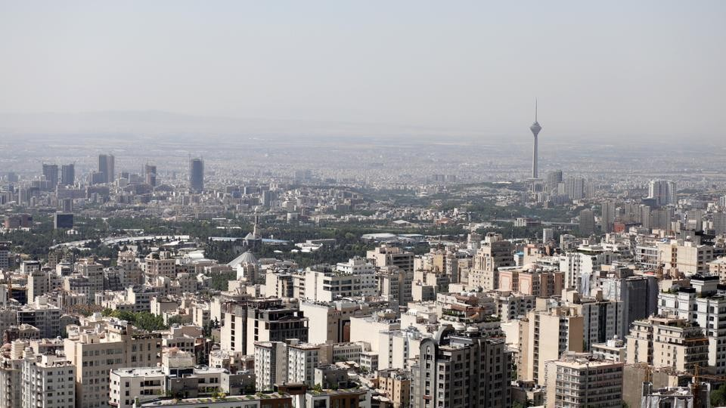
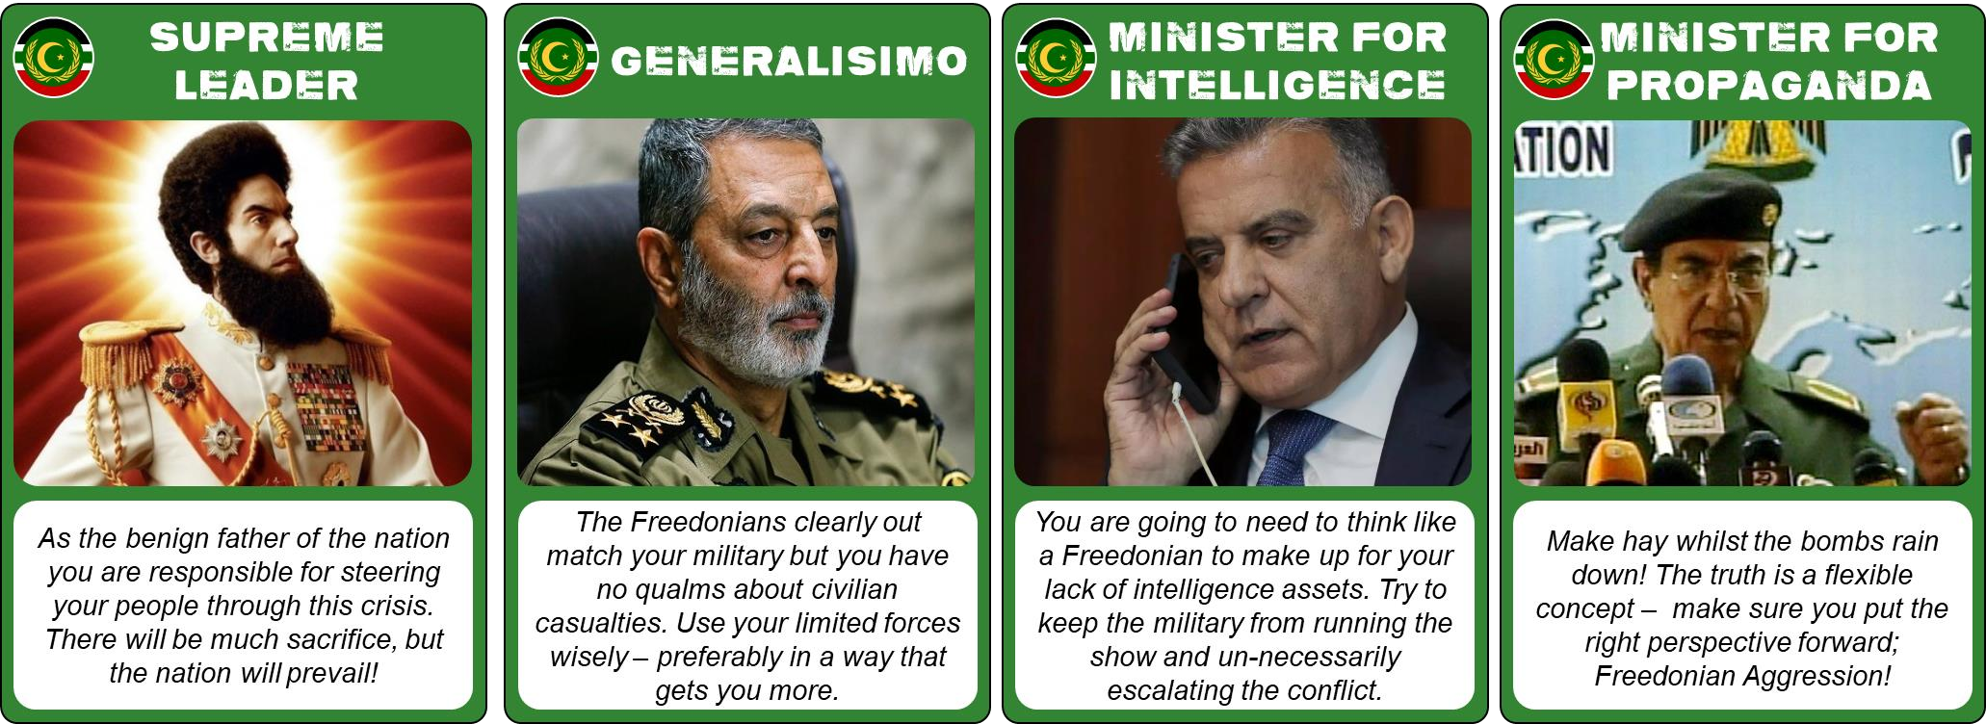
ISLAMIC REPUBLIC OF
AUTHORITANIA
A rising power, rich from oil wealth and fuelled by radical expansionist ambitions.
NATIONAL CHARACTER
A closed, controlled, xenophobic society
Leadership unaccountable to the people
Limited military and intelligence capabilities
Higher tolerance for civilian damage
Higher tolerance for extended conflicts

Slide 6
INFRASTRUCTURE
A1 | A2 | A3 | A4 | A5 | A6 | A7 | A8 | A9 | A10
B1 | B2 | B3 | B4 | B5 | B6 | B7 | B8 | B9 | B10
C1 | C2 | C3 | C4 | C5 | C6 | C7 | C8 | C9 | C10
D1 | D2 | D3 | D4 | D5 | D6 | D7 | D8 | D9 | D10
E1 | E2 | E3 | E4 | E5 | E6 | E7 | E8 | E9 | E10
F1 | F2 | F3 | F4 | F5 | F6 | F6 | F8 | F9 | F10
G1 | G2 | G3 | G4 | G5 | G6 | G7 | G8 | G9 | G10
H1 | H2 | H3 | H4 | H5 | H6 | H7 | H8 | H9 | H10
I1 | I2 | I3 | I4 | I5 | I6 | I7 | I8 | I9 | I10
J1 | J2 | J3 | J4 | J5 | J6 | J7 | J8 | J9 | J10
SAM
ARMS MANUFACTURING
SAM
MILITARY BASE
MISSILE SILO
GOVERNMENT CAPITOL
AIR BASE
PRESIDENTIAL PALACE
MIL HQ
MILITARY BASE
ARMS MANUFACTURING
INTEL
EU EMBASSY
MOSQUE
SCHOOL
STADIUM
CATHEDRAL
HOSPITAL
CULTURAL
POWER PLANT

Slide 7
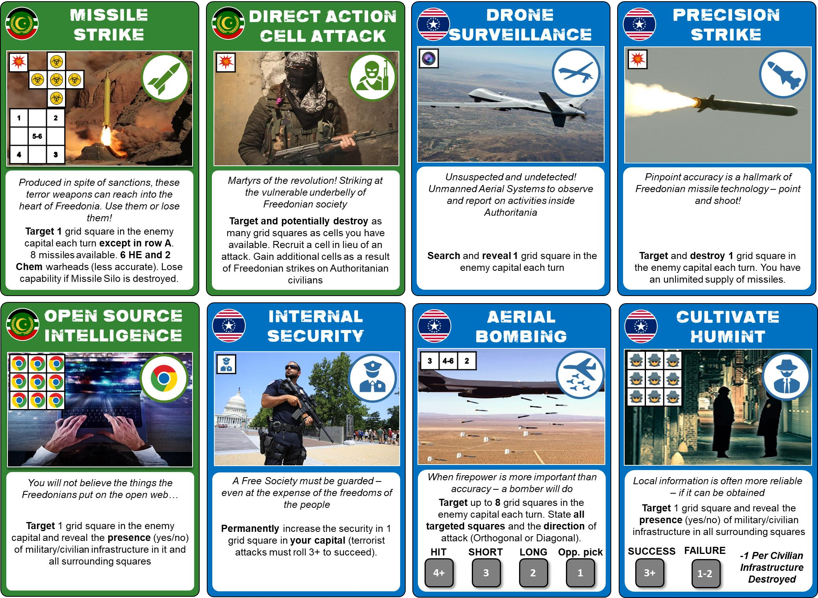
CAPABILITIES
MISSILE SILO
SAM

Slide 8
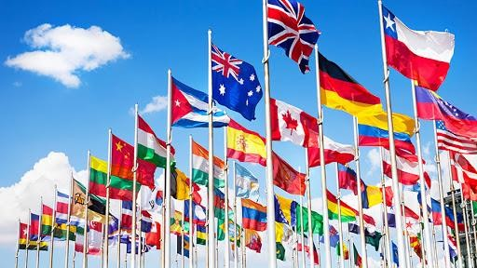
INTERNATIONAL OPINION
BACKING
FREEDONIA
SUPPORTING
FREEDONIA
SYMPATHETIC
FREEDONIA
NEUTRAL
SYMPATHETIC
AUTHORITANIA
SUPPORTING
AUTHORITANIA
BACKING
AUTHORITANIA
FreedonianTruthBombs
@pofnews
Whose narrative do you believe?
AuthoritanianHonesty
@islamrepauthnews
Write your tweet here (280 character limit)
Write your tweet here (280 character limit)
#C606
Post 1 picture here
Post 1 picture here
Turn
Turn

Slide 9
ROAD TO WAR
3 Years Ago – Authoritania begins secret
WMD programme
2 Years Ago – Freedonia discovers and reveals Authoritanian weapons programme to the World.
18 Months Ago – United Nations agree economic sanctions against Authoritania as
6 Months Ago – Authoritania conducts public test of their secret rock program
3 Months Ago – United Nations vote against military action to compel Authoritanian disarmament
Today – Freedonians declare unilateral military action to ‘disarm’ Authoritania and restore peace and stability to the region

Slide 10
EXAMPLE TURN
TURN 1A
“Open source intelligence on D6”
Checks square D6
“No civilian infra, yes to mil infra”
TURN 1F
“Drone Surveillance on F3”
Checks square F3
“Arms Manufacturer”
TURN 2A
“Direct Action Attack D6, D5, D7”
Checks squares for Internal Security and infra
“No internal security. Hit civilans and Military HQ”
TURN 2F
“Bomber strikes on F3 N-S, F2 N-S and F1 N-S”
Checks for SAM sites adjacent to targets
“No SAMs”
Rolls a die (via umpire) for each bomber
Checks squares based on die result
“Hit mil infra F3, Hit civ infra E2, Hit civs F2”

Slide 11
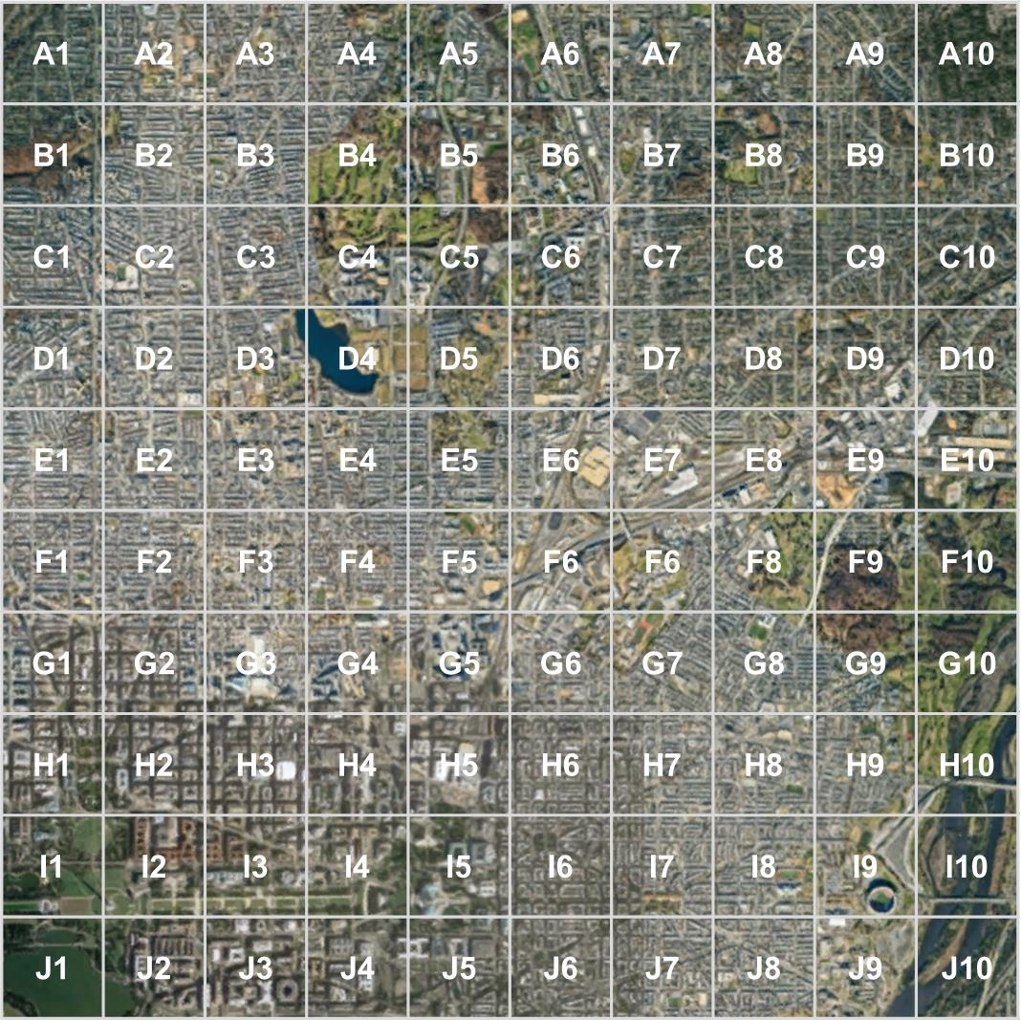
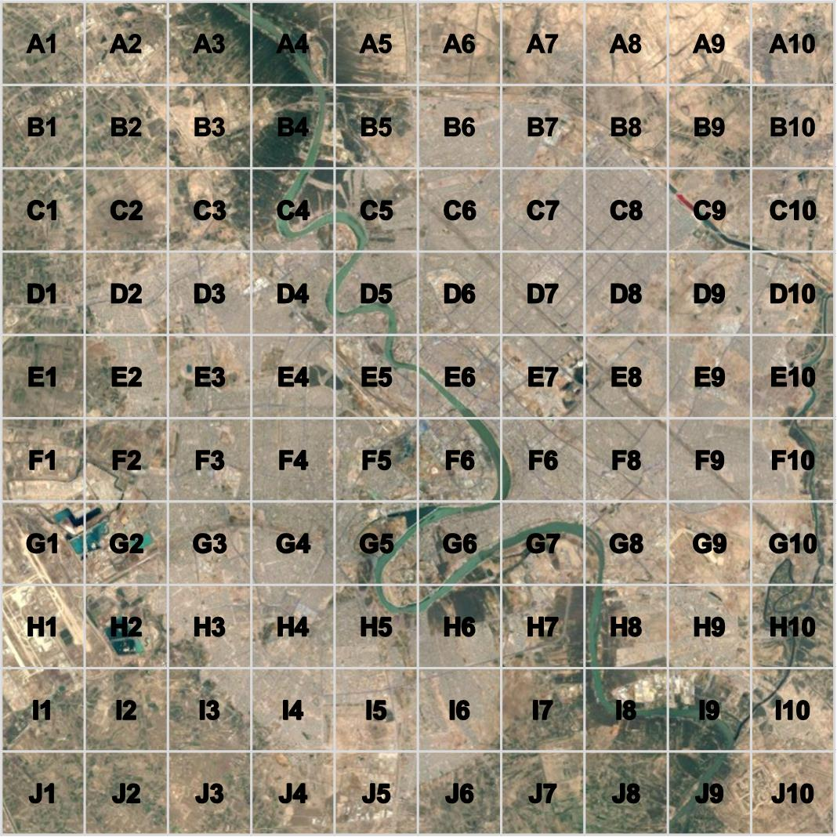
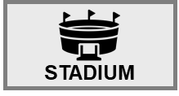
CIVILIAN INFRASTRUCTURE
TURN 23
CIVCAS
CIVILIAN INFRASTRUCTURE
MILITARY INFRASTRUCTURE
MILITARY INFRASTRUCTURE
 |  |  |  |  |  |  |  |  |  |  |  |  |  |  |  |  | 19 | 5
F7
F7

Slide 12
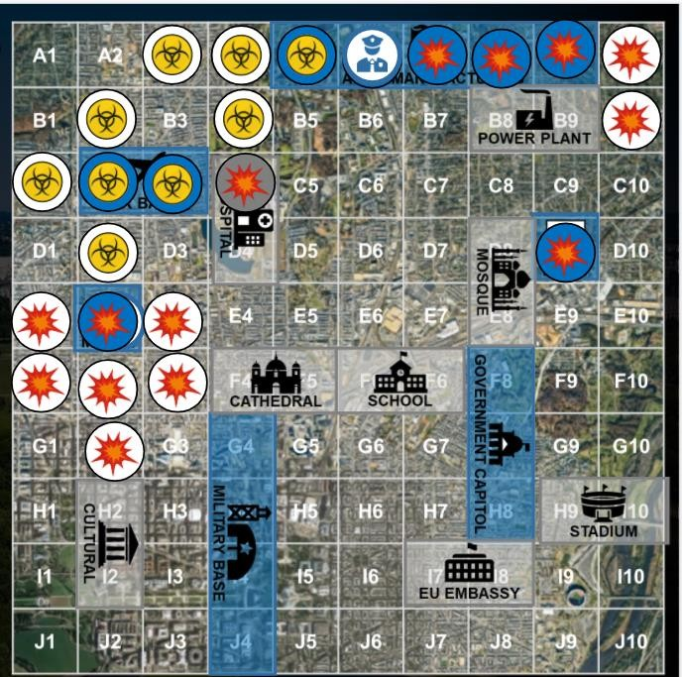
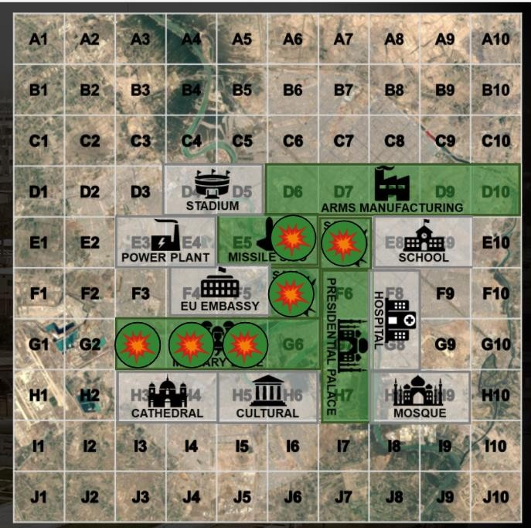
CIVILIAN INFRASTRUCTURE
TURN 23
CIVCAS
CIVILIAN INFRASTRUCTURE
MILITARY INFRASTRUCTURE
MILITARY INFRASTRUCTURE
 |  |  |  |  |  |  |  |  |  |  |  |  |  |  |  |  | 19 | 5

Slide 13
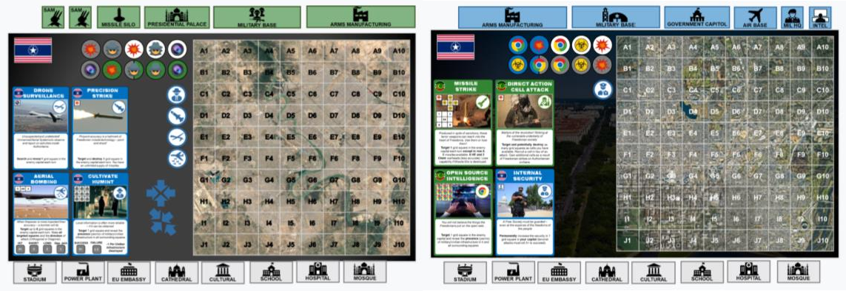
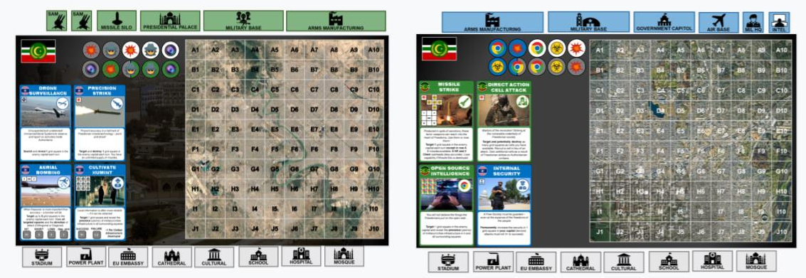
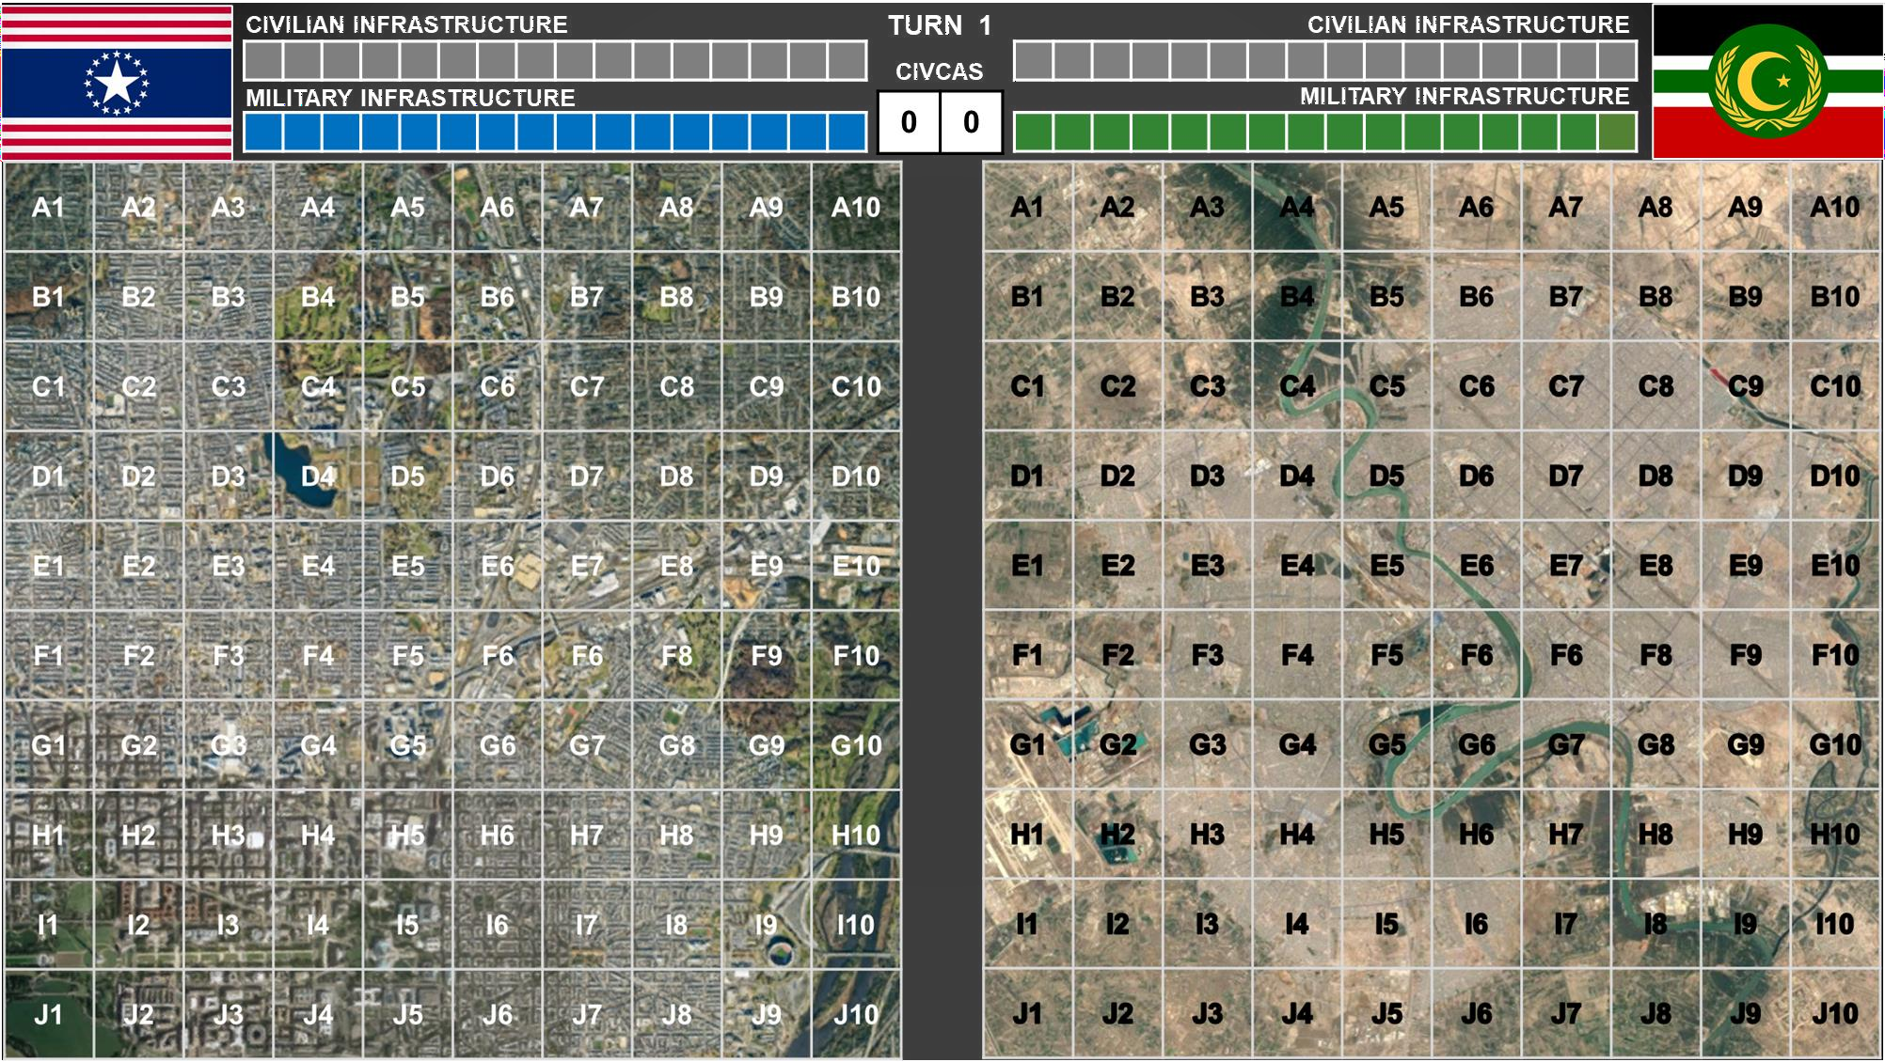
FREEDONIAN TEAM HQ (Google Slides)
AUTHORITANIAN TEAM HQ (Google Slides)
TEAM CHAT
TEAM CHAT

Slide 14
INTERNATIONAL OPINION
BACKING
FREEDONIA
SUPPORTING
FREEDONIA
SYMPATHETIC
FREEDONIA
NEUTRAL
SYMPATHETIC
AUTHORITANIA
SUPPORTING
AUTHORITANIA
BACKING
AUTHORITANIA
FreedonianTruthBombs
@pofnews
Whose narrative do you believe?
AuthoritanianHonesty
@islamrepauthnews
Write your tweet here (280 character limit)
Write your tweet here (280 character limit)
#C606
Post 1 picture here
Post 1 picture here
Turn
Turn

Slide 15
CIVILIAN INFRASTRUCTURE
TURN 23
CIVCAS
CIVILIAN INFRASTRUCTURE
MILITARY INFRASTRUCTURE
MILITARY INFRASTRUCTURE
 |  |  |  |  |  |  |  |  |  |  |  |  |  |  |  |  | 19 | 5
F7
F7

Slide 16
INTERNATIONAL OPINION
BACKING
FREEDONIA
SUPPORTING
FREEDONIA
SYMPATHETIC
FREEDONIA
NEUTRAL
SYMPATHETIC
AUTHORITANIA
SUPPORTING
AUTHORITANIA
BACKING
AUTHORITANIA
FreedonianTruthBombs
@pofnews
Whose narrative do you believe?
AuthoritanianHonesty
@islamrepauthnews
Write your tweet here (280 character limit)
TWhreiteIsylaomurictwReeeptuhbelirceo(f2A80utchhoarirtantiearcliomnidt)emns the illegal and wanton acts of aggression by Freedonia, and calls on the world to take action against this blatant attack on the principles of international law and national sovereignty.
#C606
Post 1 picture here
Post 1 picture here
Turn
_{T}Tu_{u}rn_{rn}

Slide 17
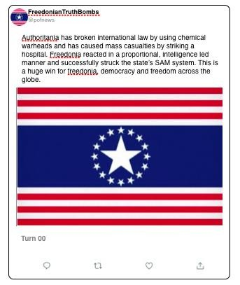
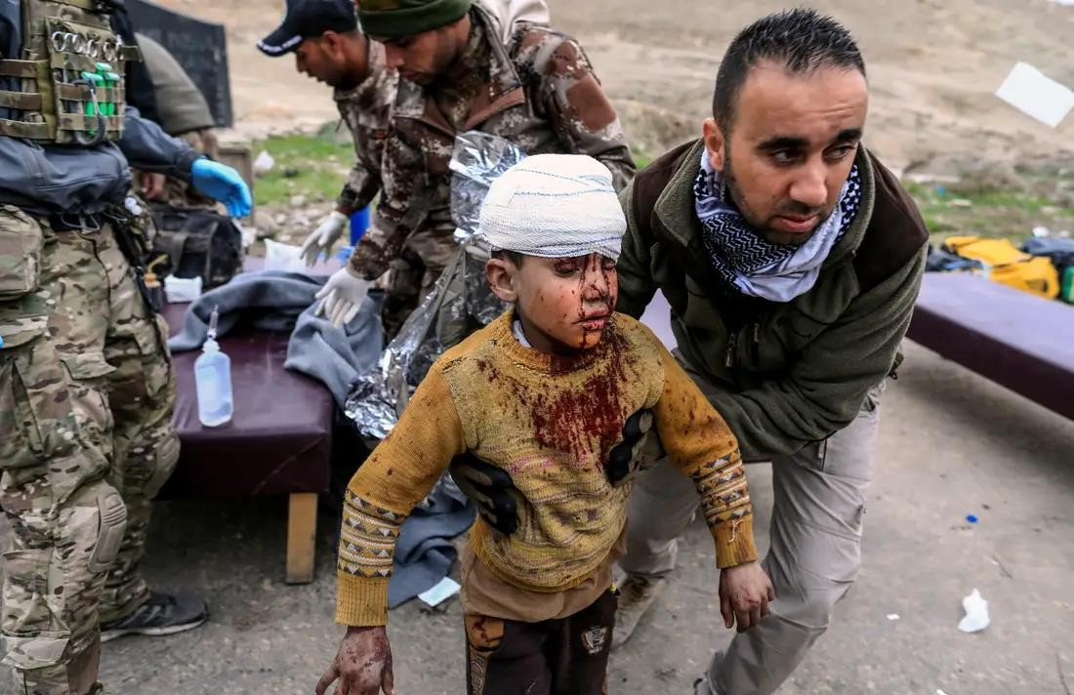
INTERNATIONAL OPINION
BACKING
FREEDONIA
SUPPORTING
FREEDONIA
SYMPATHETIC
FREEDONIA
NEUTRAL
SYMPATHETIC
AUTHORITANIA
SUPPORTING
AUTHORITANIA
BACKING
AUTHORITANIA
FreedonianTruthBombs
@pofnews
Whose narrative do you believe?
AuthoritanianHonesty
@islamrepauthnews
Write your tweet here (280 character limit)
The Freedonians have illegally attacked Authoritania and killed helpless civilians. So much for freedom when freedom only applies to those who live within the military complex that is Freedonia.
#C606
Post 1 picture here
Post 1 picture here
Turn
Turn

Slide 18
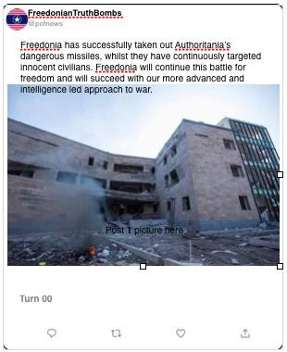
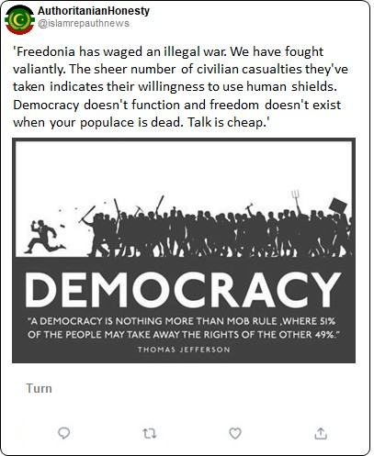
INTERNATIONAL OPINION
BACKING
FREEDONIA
SUPPORTING
FREEDONIA
SYMPATHETIC
FREEDONIA
NEUTRAL
SYMPATHETIC
AUTHORITANIA
SUPPORTING
AUTHORITANIA
BACKING
AUTHORITANIA
FreedonianTruthBombs
@pofnews
Whose narrative do you believe?
AuthoritanianHonesty
@islamrepauthnews
Write your tweet here (280 character limit)
#C606
Post 1 picture here
Post 1 picture here
Turn
Turn

Slide 19
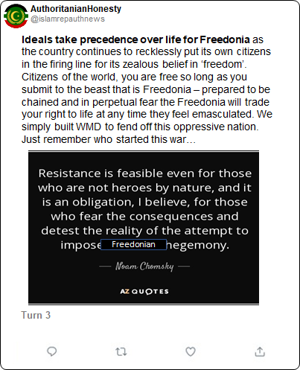
INTERNATIONAL OPINION
BACKING
FREEDONIA
SUPPORTING
FREEDONIA
SYMPATHETIC
FREEDONIA
NEUTRAL
SYMPATHETIC
AUTHORITANIA
SUPPORTING
AUTHORITANIA
BACKING
AUTHORITANIA
FreedonianTruthBombs
@pofnews
Whose narrative do you believe?
AuthoritanianHonesty
@islamrepauthnews
Write your tweet here (280 character limit)
#C606
Post 1 picture here
Post 1 picture here
Turn
Turn

Slide 20
Whose narrative do you believe?
ⓘ Start presenting to display the poll results on this slide.

Slide 21
NEXT ACTIONS
In your teams identify who is to play what role (Political Leader, Military Head, Intelligence Head, Media). If you can’t agree then distribute at random.
Spend some time together discussing your own and the opposing team’s capabilities
Place your capital city’s civilian and military infrastructure
Consider where your opponent might place their own infrastructure
Craft your first tweet based on the road to war material. This will be used on turn 0 of the game as a check that you have understood the international opinion round.

Slide 22
POST GAME DISCUSSION
The need for planning
Understanding capabilities
The value of intelligence and process
A thinking enemy
Ethical behaviour
Deception
Drones vs human intelligence or spies
Security risks of an open society
Emotional over-reactions
Military defeat does not equal victory
Game bias?
Fairness in games
Political Control of the military
Restraint and information
Terrorism is all about perspective
What was ‘unrealistic’?
How could this be modelled?

